Slide 1
ZHUQIJIN
☺
朱
启
津
About me:
Single(-.-) ;QingDao ;basketball;movie;music;

Slide 2
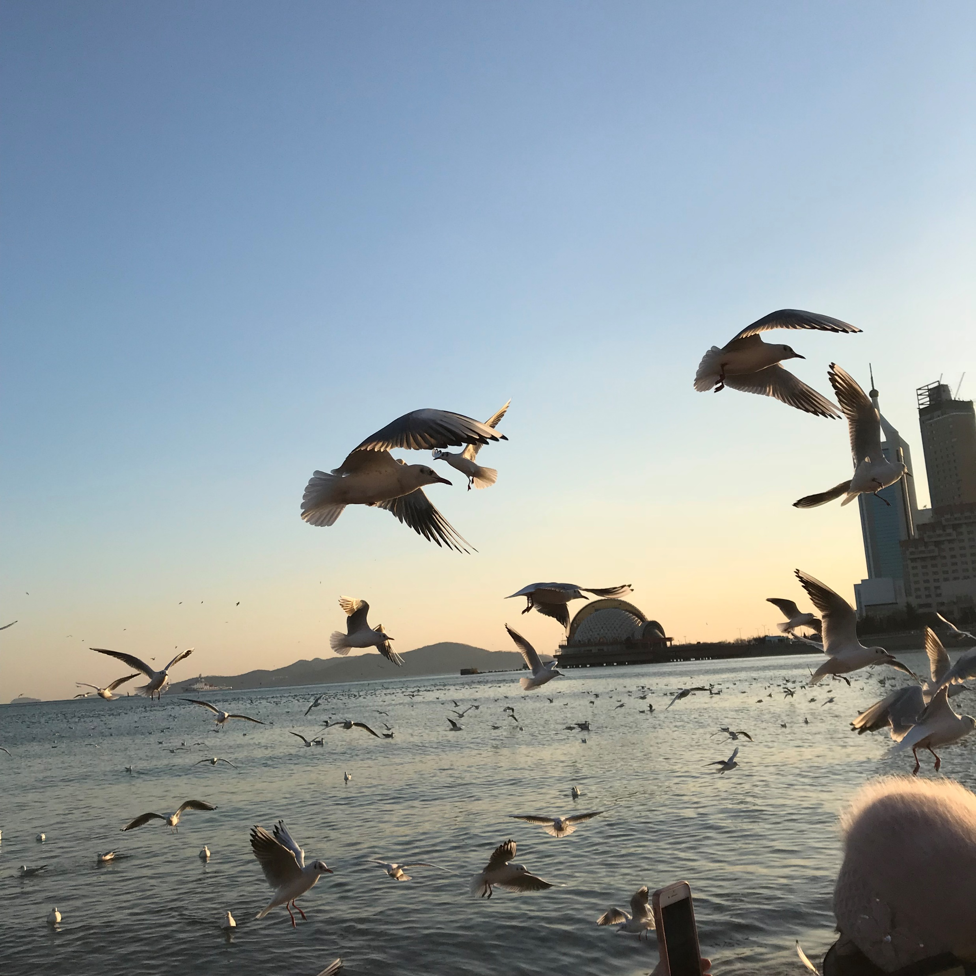
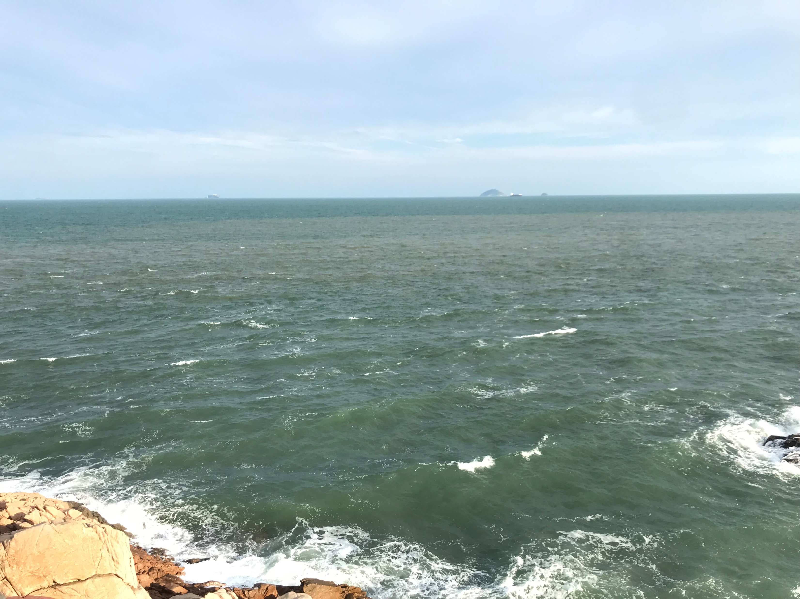
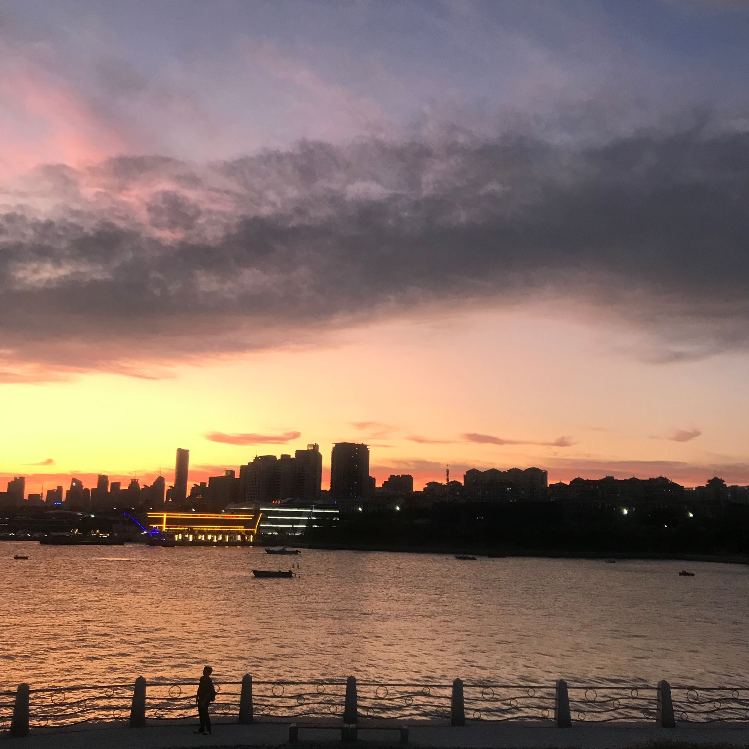
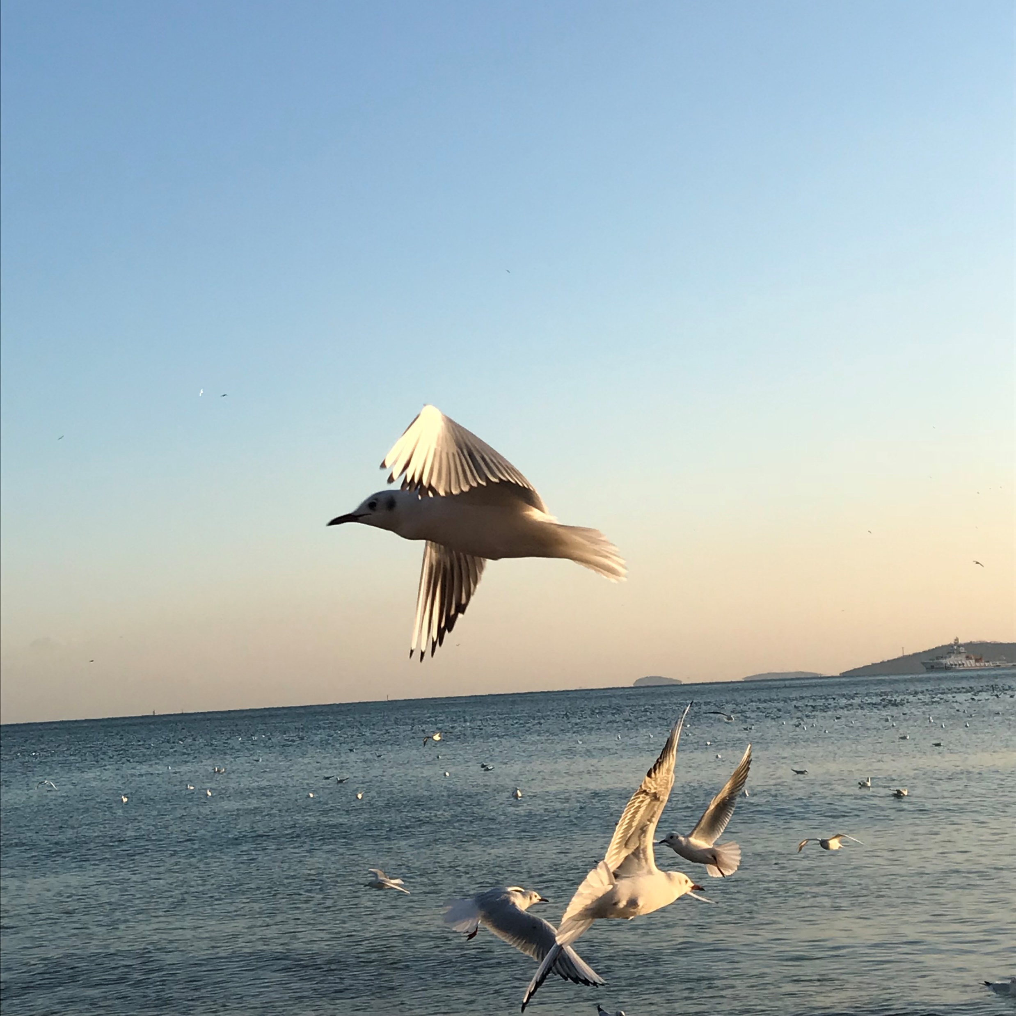
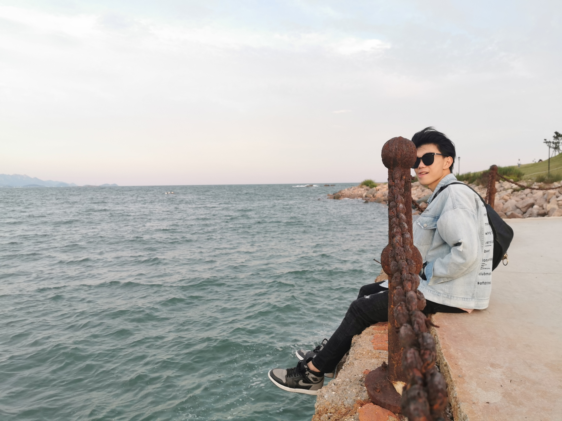
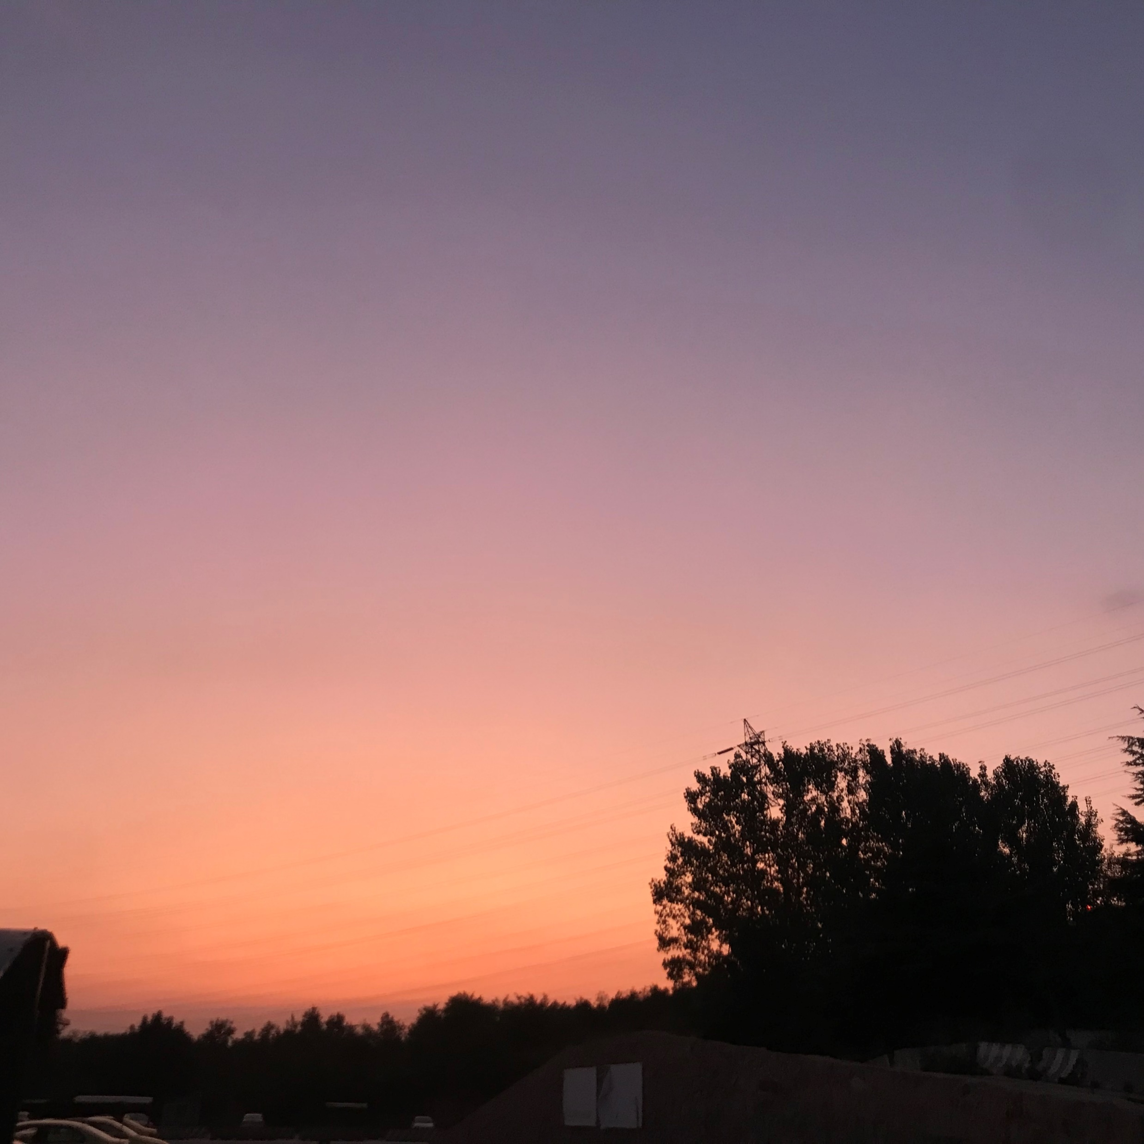
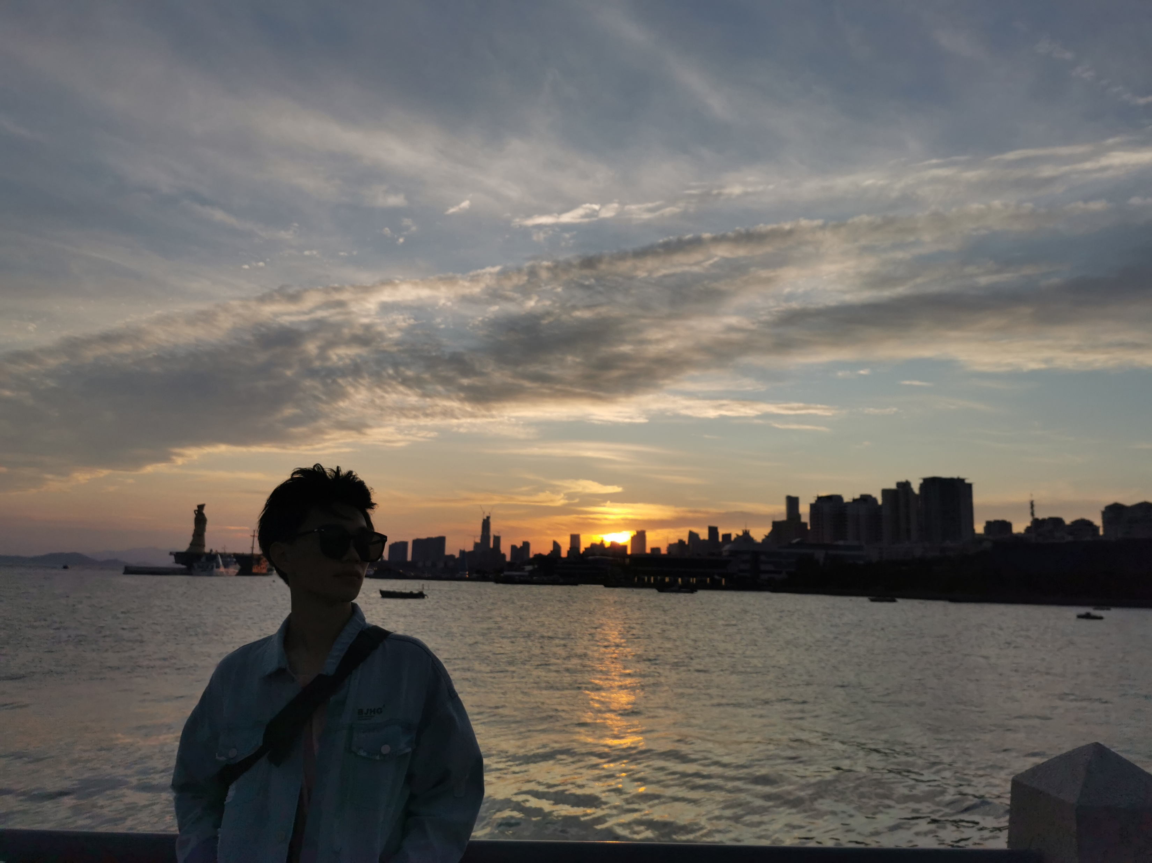
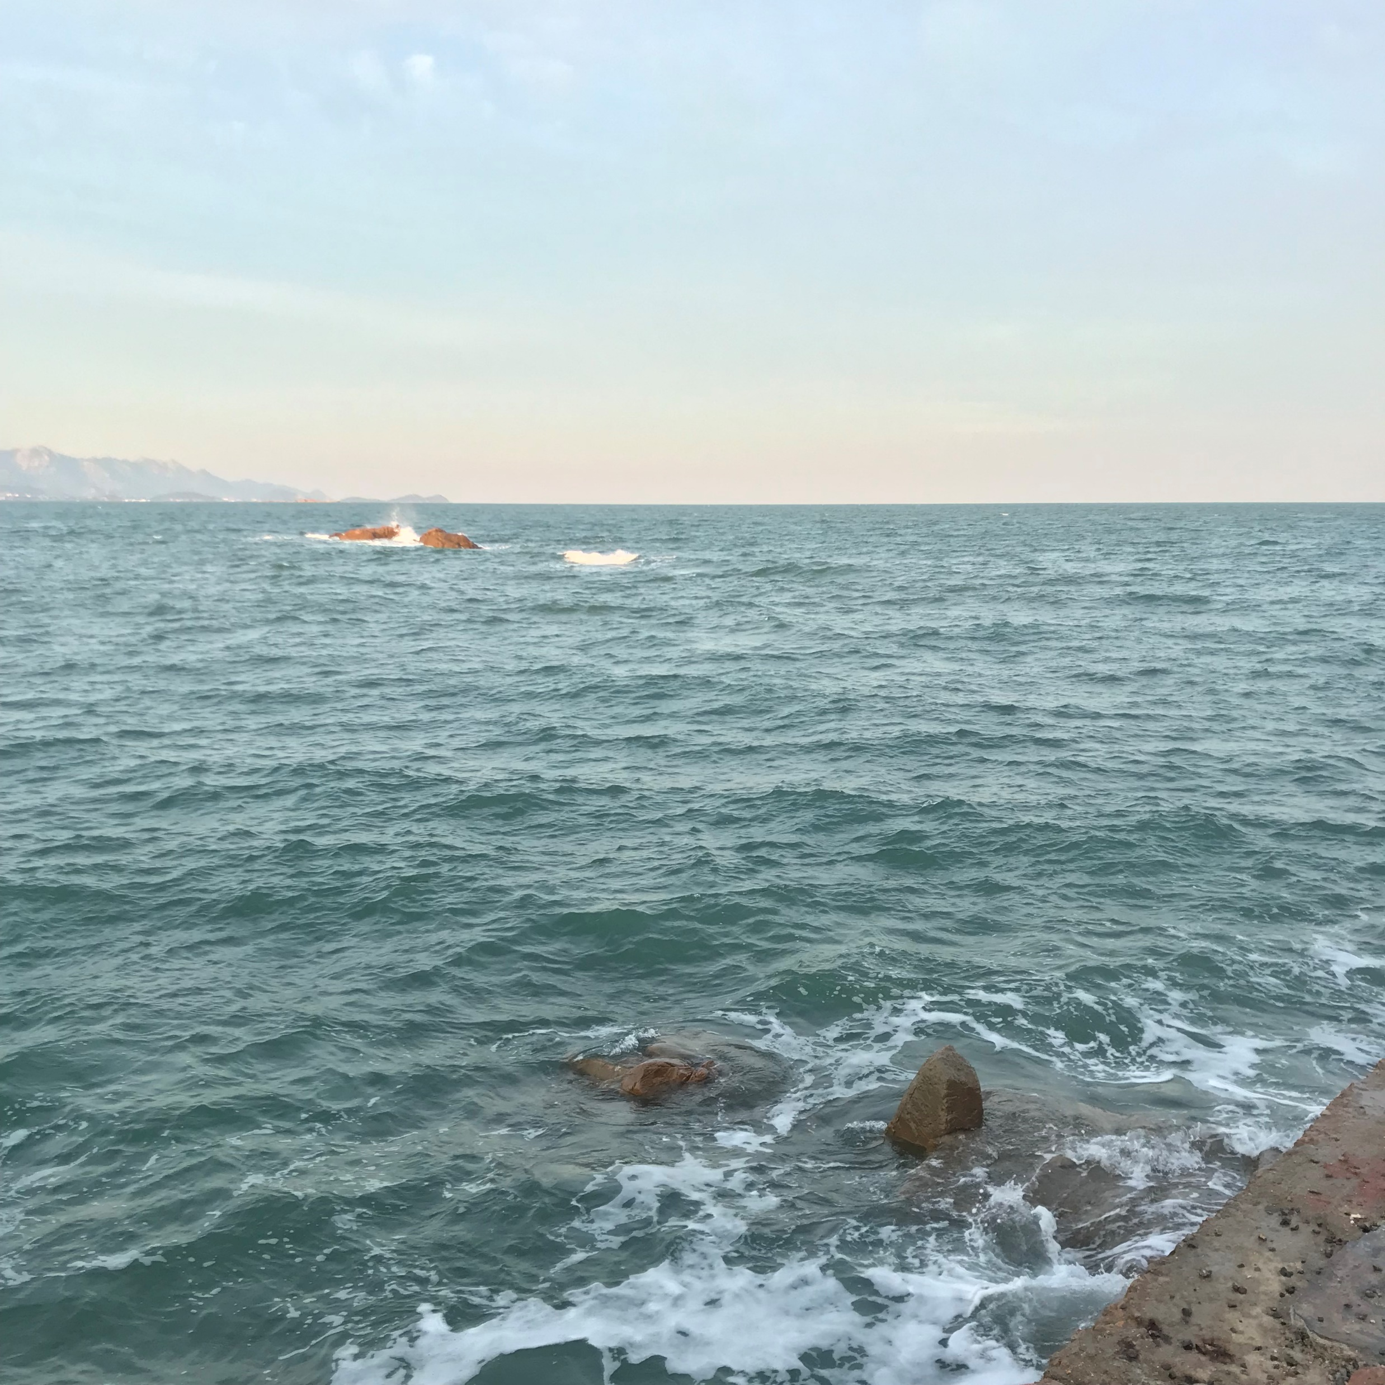
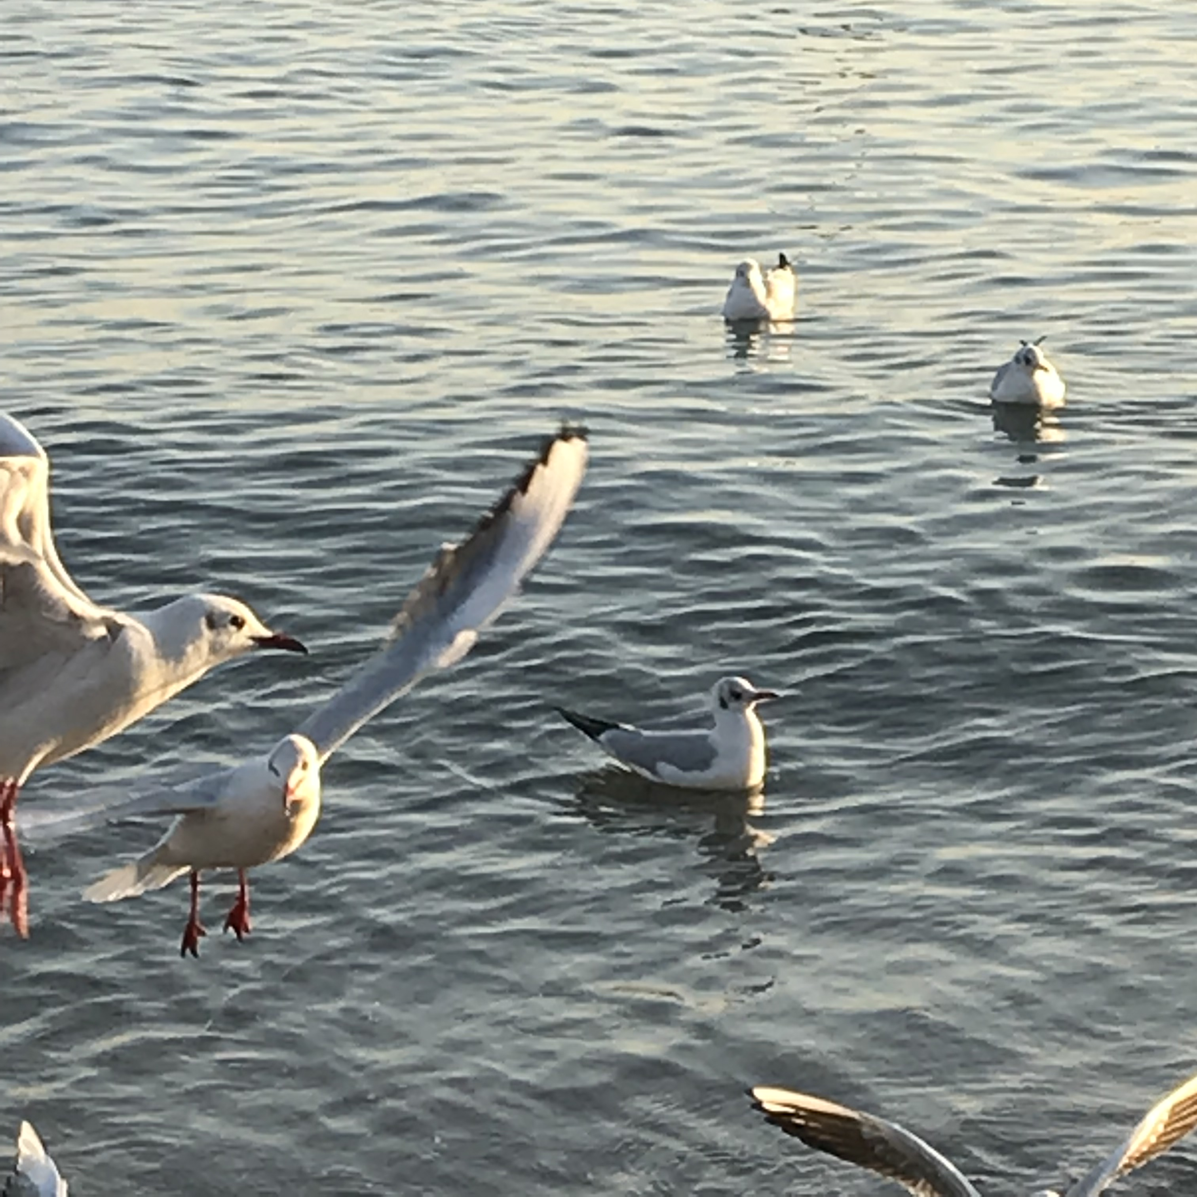
From QingDao,China
Which is a picturesque city.

Slide 3
A little of my own thoughts------
I am very optimistic and easy to get along with. I have many friends. Teamwork spirit is very important is my age. I think if we want to make a big achievement, it’s to learn how to cooperate with other people. My motto is “character determine destiny”, so I always remind myself to be honest and modest to everyone.

